Slide 1

Introduction to Wireless Sensor Networks
by Shahriar Yazdipour
Complex Embedded Systems
Technische Universität Ilmenau
June 2020

Slide 2
Agenda
3 Era of Computing
What Are Wireless Sensor Networks?
Typical Scenarios and Applications
Design Challenges
Locally Available Resources
Diversity and Dynamics
Dependability

Slide 3
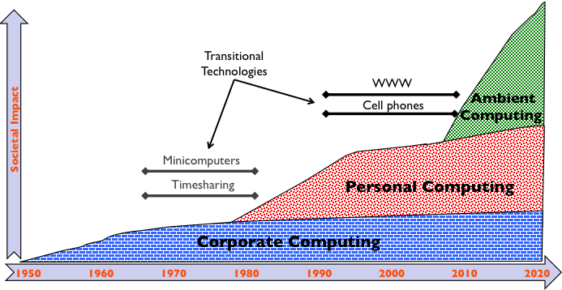
3 Era of Computing
Each of these eras represents a major difference in the role computers play in human life and society.

Slide 4
first era
The Corporate Computing Era
To enhance and empower large organizations (commercial enterprises and governments)
Share mainframe among
High cost to provide
Huge maintenance cost
http://www.wirfs-brock.com/allen/posts/74

Slide 5
second era
Personal Computers Era
Cheaper
Smaller
Affordable
Average user has access more than one
Cell Phones
Rise of internet
http://www.wirfs-brock.com/allen/posts/74

Slide 6
third era
Also called post-PC, Cloud Computing, mobile, IoT era
Desktop computers tend to be replaced by laptops and other portable devices
Smart Phones / PDA

Slide 7
What are Wireless Sensor Networks?
Any collection of devices
Equipped with Processor
Sensing and Communication capabilities
Being able to organize themselves into a network created in an AdHoc manner
Wireless sensor networks are one of the most important tools of the third era of computing.
Help intelligent devices around which their main purpose is monitoring the environment, alerting us of the events happening.
Notes:
(such as recording the geological activity, monitoring the chemical or biological properties of a region, or even monitoring the weather at a certain place). big power supply, and local data storage capabilities…. after a certain amount of time to collect the sensed data. If by misfortune some hardware would fail,

Slide 8
Typical Scenarios and Applications
Classification based on the complexity of the networks:
"Intelligent" warehouse
item to be monitored inside a warehouse is "tagged" with a small device
tags are monitored by the fixed sensor nodes embedded into the walls and shelves
Environmental monitoring
Disaster monitoring category
Help humans estimate the effects of the disaster, build maps of the safe areas
Very large-scale sensor networks applications
scenario of a large city where all the cars have integrated sensors
sensor nodes communicate with each other collecting traffic information, routes, and special traffic conditions

Slide 9
Typical Scenarios and Applications
Classification based on their area of application
Military applications
Environmental applications
Several aspects of the wildlife are being studied (movement of birds, animals, and even insects)
Healthcare applications
An increasing interest is being shown to the elder population (in home and hospitals)
Home applications
Home security devices
Other commercial applications

Slide 10
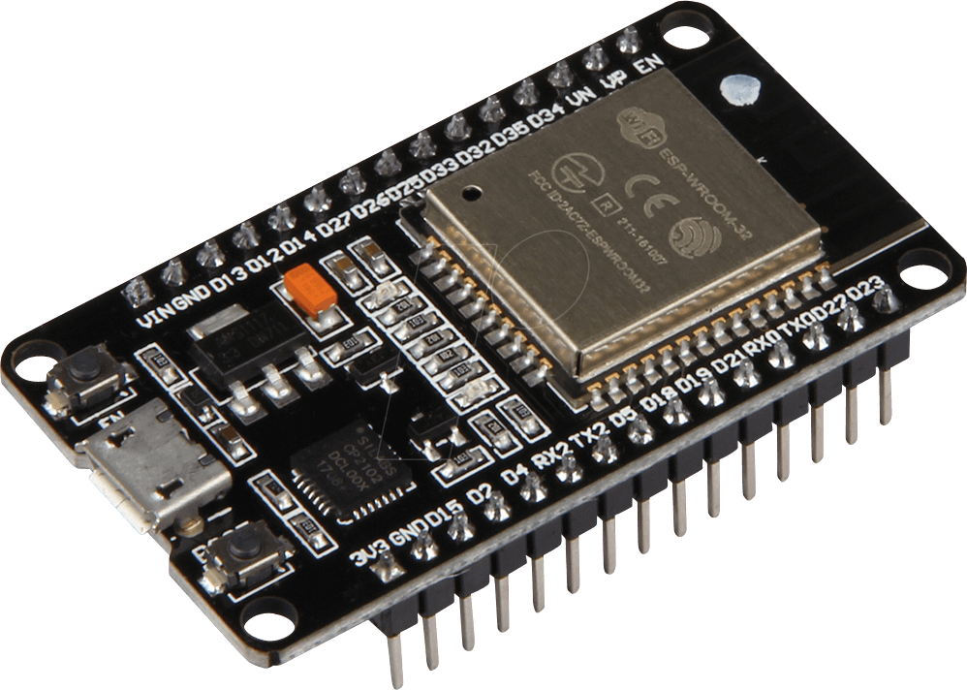
ESP32
DEBO JT ESP32 Development boards
ESP32 Wi-Fi and Bluetooth module
Wireless standard: 802.11 b/g/n
Frequency: 2.4 GHz
Bluetooth: Classic / LE
Operating voltage: 3.3 V (can be operated via 5-V micro-USB)
Operating temperature: -40 to 125°C

Slide 11
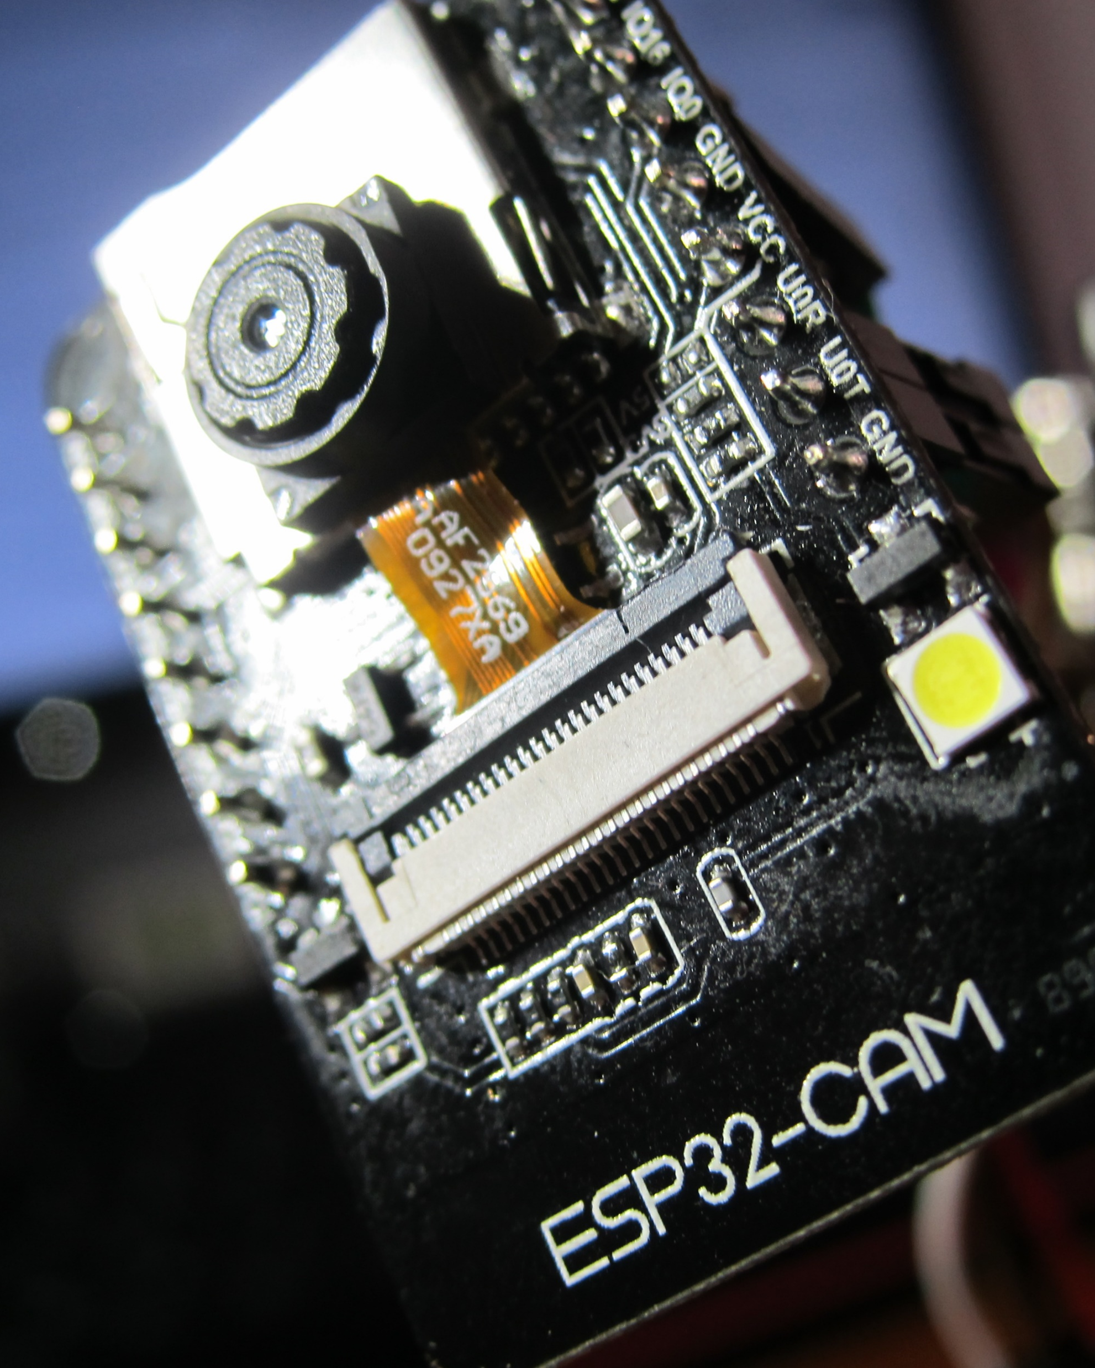
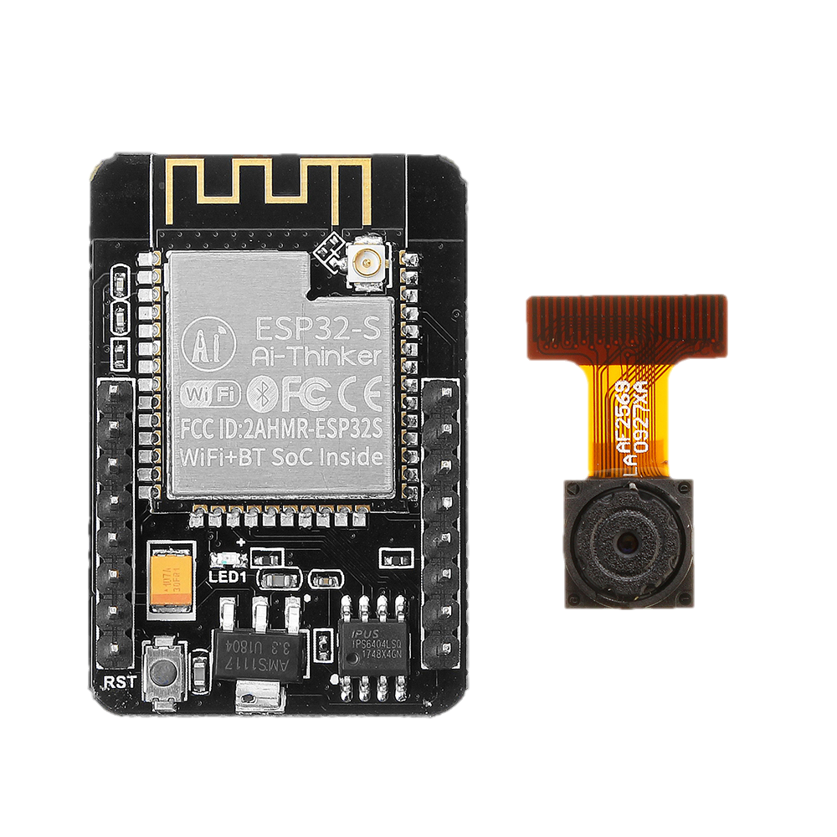
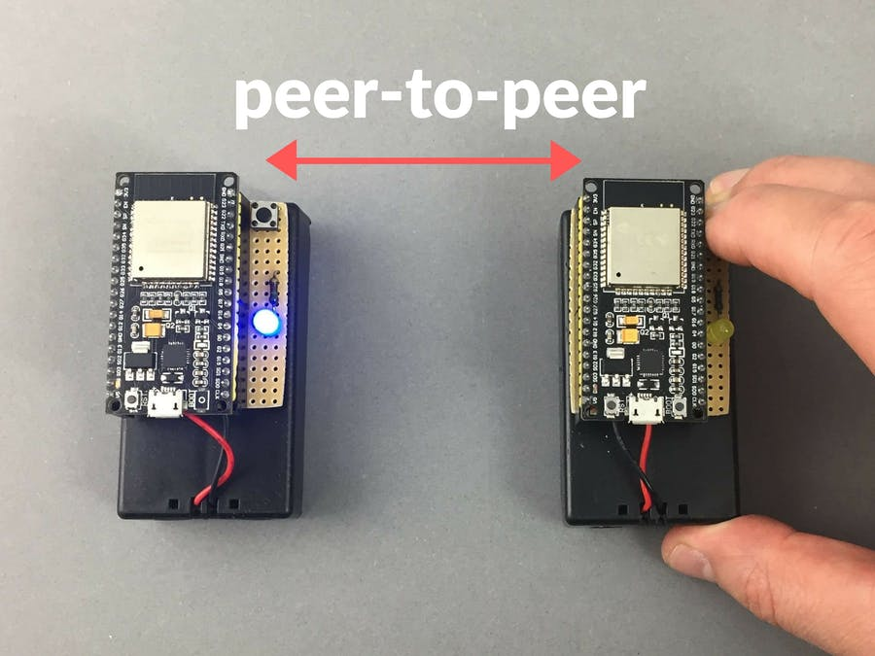
Small & Capable
https://robotzero.one/esp32-camera-module/ https://www.hackster.io/donowak/esp32-to-esp32-communication-over-the-internet-9799df

Slide 12
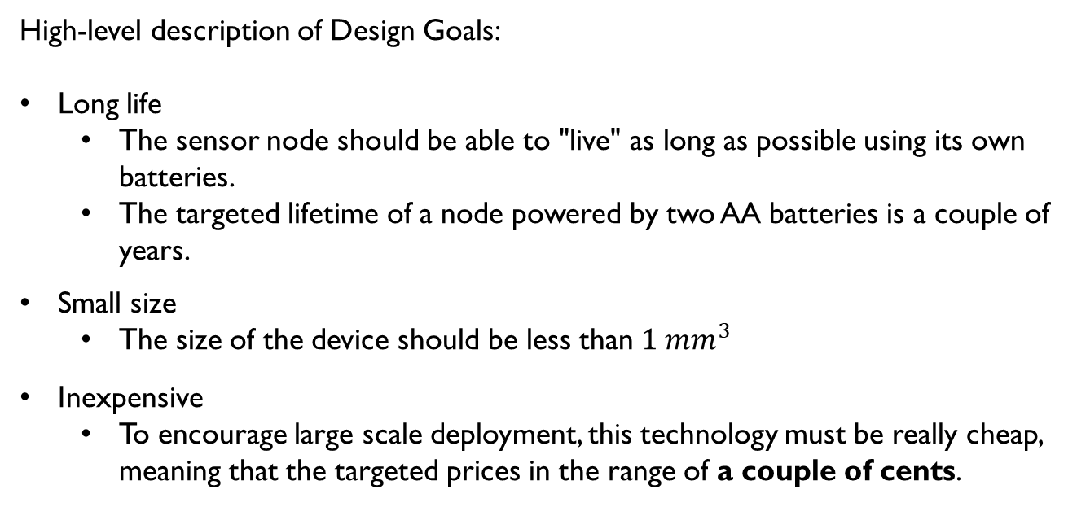
Design Challenges
High-level description of Design Goals:
Long life
The sensor node should be able to "live" as long as possible using its own batteries.
The targeted lifetime of a node powered by two AA batteries is a couple of years.
Small size
The size of the device should be less than ${1 mm}^{3}$
Inexpensive
To encourage large scale deployment, this technology must be really cheap, meaning that the targeted prices in the range of a couple of cents.
Notes:
Recently, the processor and the radio were integrated in a chip having a size of approximately 1mm. What is left is the antenna, the sensors themselves, and the battery

Slide 13
Design Challenges Locally Available Resources
Small size comes with the disadvantage of very limited resources availability
Limited processing power
Low-rate unreliable wireless communication
Smaller memory footprint
Lower energy - the most important design constraint.
So:
Each components must be optimized to obtain minimum energy consumption.
Spend all the idle time in a deep power down mode.
When active, employ scheduling schemes that take into consideration voltage and frequency scaling.

Slide 14
Design Challenges Diversity and Dynamics
Diversity:
There may be several kinds of sensor nodes present inside a single sensor network.
Combining sensing parameters from different sensors and then make a single decision (data-fusion).
For example: To detect if fire has started:
Light
Temperature
Smoke, etc.
Dynamic: Sensor nodes are to be deployed in the real world, most probably in harsh and dynamic environments.
Failures at random times
Influence on the algorithms

Slide 15
Design Challenges Dependability
More than any other sort of computer network, the wireless sensor networks are subject to failures.
High probability of failure
Algorithms must employ some form of robustness in front of the failures
Effect on the energy, memory cost, so it must keep failures at a minimum.
This scenario hardly ever happens simultaneously for all the layers and a combination of lower layer protocols could eliminate such a scenario.
The preferred approach is that of cross-layer designing and studying of the sensor node as a whole object rather than separate building blocks
The medium has an important factor in disturbance.
Even with a perfect environment, collisions will occur due to the imprecise local time estimates and lack of synchronization.

Slide 16
Design Challenges Dependability
Another dependability attribute is Security:
The communication channel is opened and cannot be protected.
This means that others can intercept and to disrupt the transmissions or even to transmit their own data.
In addition to accessing private information, a third party could also act as an attacker that wants to disrupt the correct functionality of the network.
The usual protection schemes require too much memory and too much computation power to be employed (the keys themselves are sometimes too big to fit into the limited available memory)

Slide 17
next
The following chapters of the book will focus on
Particular Issues
Giving more insight to the current state of the art approaches in this field.

Slide 18
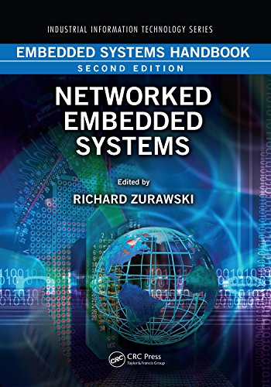
Reference
Networked Embedded Systems
by Richard Zurawski
Chapter 3

Slide 19

Thank you Q / A

